Slide 1
The Cloud

Slide 2
Objectives
Understand what “The Cloud” is
Discuss key components of “The Cloud”
Explain why “The Cloud” is so important

Slide 3
Definition
NIST SP-800-145 defines cloud computing as:
“A model for enabling ubiquitous, convenient, on-demand network access to a shared pool of configurable computing resources (e.g., networks, servers, storage, applications, and services) that can be rapidly provisioned and released with minimal management effort or service provider interaction. This cloud model promotes availability and is composed of five essential characteristics, three service models, and four deployment models.”

Slide 4
How I define “The Cloud”
It’s really just someone else’s computer.
On someone else’s network
With someone else’s policies in place

Slide 5
As a Service
SaaS
Software
Think of software on your computer
PaaS
Platform
Think of your operating system
IaaS
Infrastructure
Think of your computer
Others
Network
Data

Slide 6
Components of the cloud
Rapid, often on demand deployment
Flexible architecture
Resource pooling
Resource measuring

Slide 7
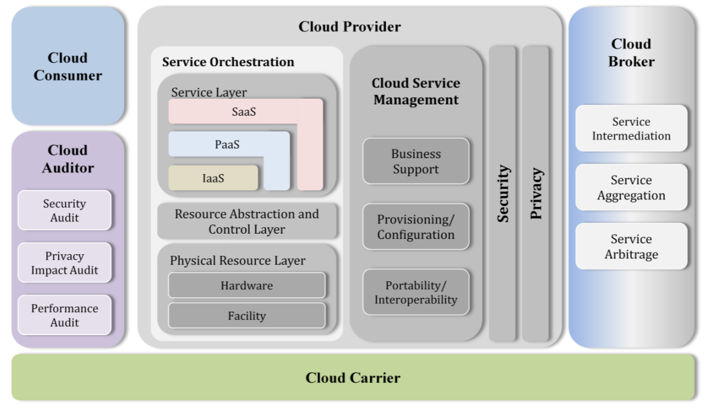
Reference Architecture
NIST 500-292

Slide 8
Why is the cloud so important
Allows us to rapidly deploy
Allows diversification of architecture, location
Security
Sometimes decreased workload
Disaster Recovery

